Slide 1
Carbon Budgets and CO2 Emission Pathways
Bruce Parker
January 19, 2026
This presentation will discuss a revised carbon budget and its impact on CO2 Emission Pathways

Slide 2
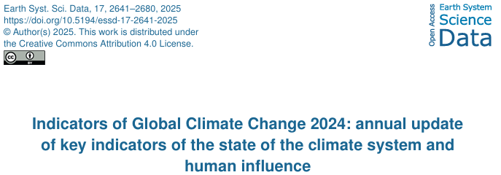
Revised Carbon Budget
https://essd.copernicus.org/articles/17/2641/2025/essd-17-2641-2025.pdf
An article published in June 2025 analyzed the climatic changes that have occurred since the IPPC released their post-2019 carbon budget.

Slide 3
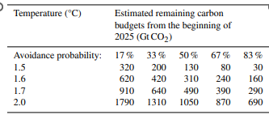
Revised Carbon Budget
https://essd.copernicus.org/articles/17/2641/2025/essd-17-2641-2025.pdf
They derived a revised carbon budget that includes four temperature increases and five avoidance probabilities

Slide 4
Revised Carbon Budget
https://essd.copernicus.org/articles/17/2641/2025/essd-17-2641-2025.pdf
For example, they calculated that the carbon budget from the beginning of 2025 through 2100 for a 67 percent chance of limiting the temperature increase to 1.5 ⁰C was about 80 billion tons

Slide 5
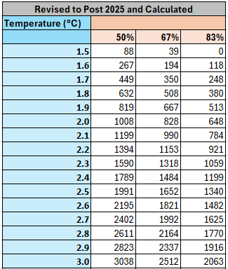
Post 2025 IPCC Carbon Budget
Based on the post-2024 carbon budget shown on the previous slide, the table at left show the post-2025 carbon budget for a range of temperature increases.
Based on the post-2024 carbon budget shown on the previous slide, the table on this slide shows the post-2025 carbon budget for a range of temperature increases.

Slide 6
Post 2025 IPCC Carbon Budget
Based on the post-2024 carbon budget shown on the previous slide, the table at left show the post-2025 carbon budget for a range of temperature increases.
Since the revised carbon budget only allows one year of CO2 emissions for a 67 percent chance of limiting the temperature increase to 1.5⁰C, I thought it would be helpful to analyze the likely impact on the temperature increase in 2100 from a variety of CO2 emission pathways
Since the revised carbon budget only allows one year of CO2 emissions for a 67 percent chance of limiting the temperature increase to 1.5⁰C, I thought it would be helpful to analyze the likely impact on the temperature increase in 2100 from a variety of CO2 emission pathways.

Slide 7
CO2 Pathways Model
The model uses two types of simplified CO2 emission pathways:
To do the analysis I created web-based model that uses two types of simplified CO2 emission pathways:

Slide 8
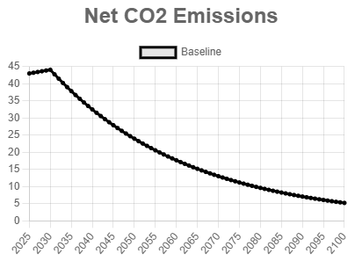
CO2 Pathways Model
The model uses two types of simplified CO2 emission pathways:
Based on an annual percentage decline in CO2 emissions
One type is based on an annual percentage decline in CO2 emissions. In this example emissions decline starting in 2030 at a three percent annual rate

Slide 9
CO2 Pathways Model
The model uses two types of simplified CO2 emission pathways:
Based on an annual percentage decline in CO2 emissions
1474 GTCO2
And Cumulative CO2 emissions from 2026 through 2100 are then 1474 billion tons

Slide 10
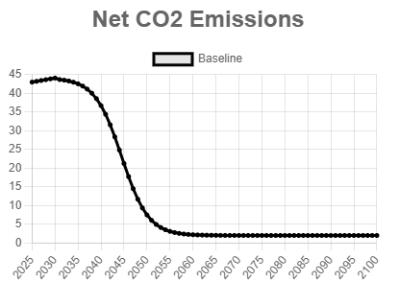
CO2 Pathways Model
The model uses two types of simplified CO2 emission pathways:
Based on an annual percentage decline in CO2 emissions
2.
Based on emissions declining for a specific number of years
1474 GTCO2
The second type is based on emissions declining for a specific number of years. In this example emissions decline for 30 years starting in 2030 and reach a minimum of three billion tons per year in 2060

Slide 11
CO2 Pathways Model
The model uses two types of simplified CO2 emission pathways:
Based on an annual percentage decline in CO2 emissions
2.
Based on emissions declining for a specific number of years
1474 GTCO2
948 GTCO2
That results in cumulative CO2 emissions of 948 billion tons. Note that neither of these pathways will keep the 2100 temperature increase under 2 degrees

Slide 12
CO2 Pathways Model
The model also allows for
CO2 emissions from carbon feedbacks
CO2 removals where the emissions occur – carbon capture and storage (CCS)
The model also allows for CO2 emissions from carbon feedbacks and CO2 removals where the emissions occur - carbon capture and storage (CCS)

Slide 13
CO2 Pathways Model
The model also allows for
CO2 emissions from carbon feedbacks
CO2 removals where the emissions occur – carbon capture and storage (CCS)
Based on a user-selected desired temperature increase, the model the calculates the quantity of CO2 that must be removed from the atmosphere (CDR) in order to meet the carbon budget for that temperature increase
Based on a user-selected desired temperature increase, the model the calculates the quantity of CO2 that must be removed from the atmosphere (CDR) in order to meet the carbon budget for that temperature increase. In other words, the user does not specify a cdr pathway – the model provides several that result in the required cumulative removals

Slide 14
CO2 Pathways Model
The model also allows for
CO2 emissions from carbon feedbacks
CO2 removals where the emissions occur – carbon capture and storage (CCS)
Based on a desired temperature increase the model then calculates the quantity of CO2 that must be removed from the atmosphere to reach that temperature increase
The model is available at http://www.co2pathways.org
A PowerPoint presentation on how to use the model can be downloaded from http://www.co2pathways.org/Downloads/CO2PathwaysModel.pptx
The model can be run at the indicated URL. And a PowerPoint presentation on how to use the model can also be downloaded

Slide 15
Analysis - Assumptions
For this analysis I’ll make the following assumptions:
The desired temperature increase in 2100 is 1.5⁰C

Slide 16
Analysis - Assumptions
For this analysis I’ll make the following assumptions:
The desired temperature increase in 2100 is 1.5⁰C
The “avoidance percentage” is 67

Slide 17
Analysis - Assumptions
For this analysis I’ll make the following assumptions:
The desired temperature increase in 2100 is 1.5⁰C
The “avoidance percentage” is 67
Anthropogenic CO2 emissions in 2025 were 43 billion tons

Slide 18
Analysis - Assumptions
For this analysis I’ll make the following assumptions:
The desired temperature increase in 2100 is 1.5⁰C
The “avoidance percentage” is 67
Anthropogenic CO2 emissions in 2025 were 43 billion tons
Anthropogenic CO2 emissions are increasing at 0.5% per year

Slide 19
Analysis - Assumptions
For this analysis I’ll make the following assumptions:
The desired temperature increase in 2100 is 1.5⁰C
The “avoidance percentage” is 67
Anthropogenic CO2 emissions in 2025 were 43 billion tons
Anthropogenic CO2 emissions are increasing at 0.5% per year
The minimum quantity of anthropogenic CO2 emissions is 3 billion tons

Slide 20
Analysis - Assumptions
For this analysis I’ll make the following assumptions:
The desired temperature increase in 2100 is 1.5⁰C
The “avoidance percentage” is 67
Anthropogenic CO2 emissions in 2025 were 43 billion tons
Anthropogenic CO2 emissions are increasing at 0.5% per year
The minimum quantity of anthropogenic CO2 emissions is 3 billion tons
There are no additional carbon feedbacks

Slide 21
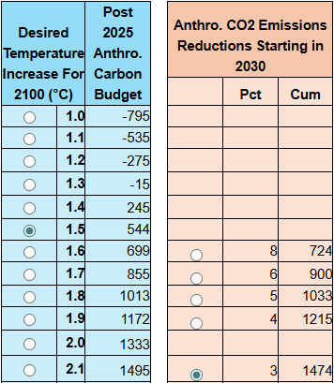
CO2 Pathways Model
For a specific year that emission reductions start, the model displays the expected temperature increases for multiple mitigation pathways. This includes:
For a specific year that emission reductions start, the model displays the expected temperature increases for multiple mitigation pathways. This includes:

Slide 22
CO2 Pathways Model
For a specific year that emission reductions start, the model displays the expected temperature increases for multiple mitigation pathways. This includes:
The carbon budget for temperature increases
The carbon budget for temperature increases

Slide 23
CO2 Pathways Model
For a specific year that emission reductions start, the model displays the expected temperature increases for multiple mitigation pathways. This includes:
The carbon budget for temperature increases
The cumulative CO2 emissions for multiple mitigation pathways
The cumulative CO2 emissions for multiple mitigation scenarios

Slide 24
CO2 Pathways Model
For a specific year that emission reductions start, the model displays the expected temperature increases for multiple mitigation pathways. This includes:
The carbon budget for temperature increases
The cumulative CO2 emissions for multiple mitigation pathways
The expected temperature increases for multiple mitigation pathways
The expected temperature increases for multiple mitigation scenarios. This provides a very quick way to compare the effectiveness of multiple mitigation pathways. Let me show you a few more examples

Slide 25
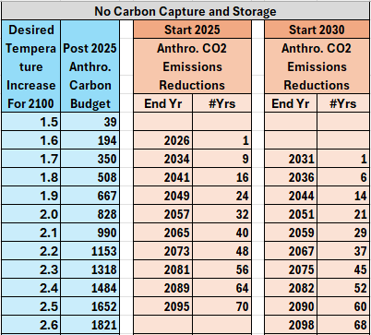
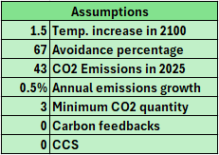
Based on Emissions Declining for a Specific Number of Years
This one is Based on Emissions Declining for a Specific Number of Years . These tables show, two start years

Slide 26
Based on Emissions Declining for a Specific Number of Years
With Multiple end years of emissions reduction that each reach 3 three billion tons per year. Note that there is no CCS

Slide 27
Based on Emissions Declining for a Specific Number of Years
For example, if the emissions decline starts in 2025 and decline to 3 billion tons in 32 years

Slide 28
Based on Emissions Declining for a Specific Number of Years
Cumulative CO2 emissions will be about 828 billion tons

Slide 29
Based on Emissions Declining for a Specific Number of Years
And the temperature increase in 2100 will be about 2 degrees. Since reducing emissions to 3 billion tons per year will likely take longer than 30 years, we should expect a temperature increase of at least two degrees if there is no carbon capture or carbon dioxide removal

Slide 30
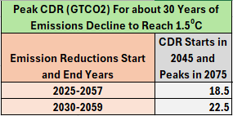
Based on Emissions Declining for a Specific Number of Years
And to reach a temperature increase of 1.5 degrees in 2100 requires that CDR peak at about 18 billion tons if it starts in 2045 and peaks in 2075

Slide 31
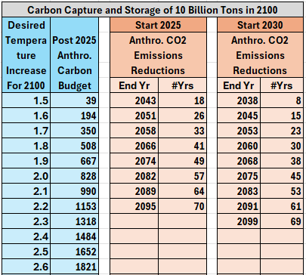
Based on Emissions Declining for a Specific Number of Years
This is an example of a path to a temperature increase of 1.5 degrees in 2100 – emission reductions need to start declining this year and reach 3 billion tons by 2058. Then

Slide 32
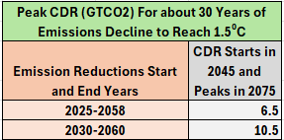
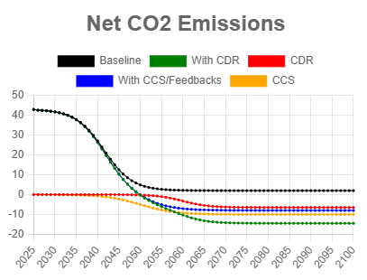
Based on Emissions Declining for a Specific Number of Years
CCS needs to reach 10 billion tons in 2100 and CDR must reach 6.5 billion tons in 2100. This is probably not realistic

Slide 33
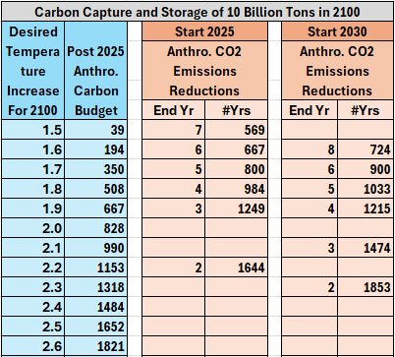
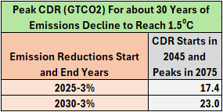
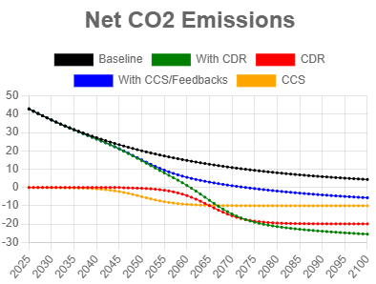
Based on an Annual Percentage Decline in CO2 Emissions
Analyzing emission reductions by annual percent reduction gives a different picture. For a three percent reduction, with 10 billion tons of CCS in 2100, the CDR requirement is around 20 billion tons per year to reach a 1.5 degree temperature increase.

Slide 34
Thoughts
By rapidly reducing GHG emissions and implementing CCS and CDR at scale, it is theoretically possible to limit the temperature increase in 2100 to 1.5⁰C

Slide 35
Thoughts
By rapidly reducing GHG emissions and implementing CCS and CDR at scale, it is theoretically possible to limit the temperature increase in 2100 to 1.5⁰C
But given the revised carbon budget of about 40 billion tons for a 67 percent chance of meeting that goal, how do we convince people that the temperature increase will likely be well over 1.5⁰C in 2100 if rely only on mitigation, CCS, and CDR?

Slide 36
Thoughts
By rapidly reducing GHG emissions and implementing CCS and CDR at scale, it is theoretically possible to limit the temperature increase in 2100 to 1.5⁰C
But given the revised carbon budget of about 40 billion tons for a 67 percent chance of meeting that goal, how do we convince people that the temperature increase will likely be well over 1.5⁰C in 2100 if rely only on mitigation, CCS, and CDR?
How can the CO2 Pathways Model and web site be improved to support our efforts?

Slide 37
Carbon Budgets and CO2 Emission Pathways
http://www.co2pathways.org
Bruce Parker
bruce@chesdata.com
January 19, 2026
Please contact Bruce Parker if you have any questions or suggestions or would like to help him with this project.

Slide 38
Additional slides

Slide 39
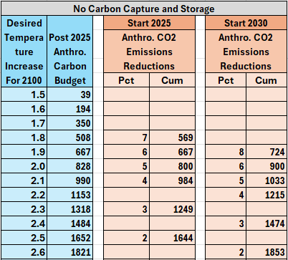
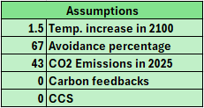
Based on an Annual Percentage Decline in CO2 Emissions
Analyzing emission reductions by percent gives a different picture.

Slide 40
Based on an Annual Percentage Decline in CO2 Emissions
Without CCS, CO2 emissions would need to be reduced by 5 percent per year to reach even a two degree temperature increase in 2100, an unprecedented rate of decline

Slide 41
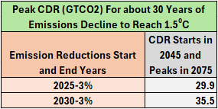
Based on an Annual Percentage Decline in CO2 Emissions
Three percent per year might be a reasonable planning number. This requires CDR of around 30 billion tons per year without ccs

Slide 42
The Need for SRM
By implementing CCS and CDR at scale it should be possible to limit the temperature increase in 2100 to less that 2.0⁰C
In order to convince people that SRM might be needed (and hence the need for R&D to study the feasibility of various SRM approaches) we need to reach agreements on:
The maximum acceptable temperature increase in 2100
A carbon budget that would provide a __% chance of meeting the temperature increase goal
Realistic CO2 emission pathways
A realistic maximum that society would be willing to spend on CDR and CSS
Cost curves for CCS and CDR “at scale”
Realistic CCS and CDR “implementation pathways”
Given the above it should be possible to determine whether or not society would be willing to allocate the necessary funds to limit the temperature increase to the maximum acceptable value.
How can the CO2 Pathways Model and web site be improved to help convince people that SRM might (or might not) be necessary?
How can the CO2 Pathways Model and web site be improved to help convince people that SRM might (or might not) be necessary?

