Slide 1
CO2 Pathways Model
http://www.co2pathways.org
Bruce Parker
January 16, 2026
This slide show demonstrates how to use the “CO2 Pathways Model”

Slide 2
CO2 Pathways Model
The “CO2 Pathways Model” was designed to allow users to explore the impact of CO2 emissions on the global temperature increase in 2100.
The “CO2 Pathways Model” was designed to allow users to explore the impact of CO2 emissions on the global temperature increase in 2100.

Slide 3
CO2 Pathways Model
The “CO2 Pathways Model” was designed to allow users to explore the impact of CO2 emissions on the global temperature increase in 2100.
The model uses a revised version of the “Post 2019 IPCC Carbon Budget” to determine the expected temperature increase in 2100 based on cumulative CO2 emissions and CCS removals.
The model uses a revised version of the “Post 2019 IPCC Carbon Budget” to determine the expected temperature increase in 2100 based on cumulative CO2 emissions and CCS removals.

Slide 4
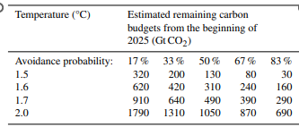
CO2 Pathways Model – Revised Carbon Budget
From: “Indicators of Global Climate Change 2024: annual update of key indicators of the state of the climate system and human influence”
https://essd.copernicus.org/articles/17/2641/2025/essd-17-2641-2025.pdf
An article published in June 2025 analyzed the climatic changes since 2020 and developed a post 2024 carbon budget.

Slide 5
CO2 Pathways Model – Revised Carbon Budget
“Indicators of Global Climate Change 2024: annual update of key indicators of the state of the climate system and human influence”
https://essd.copernicus.org/articles/17/2641/2025/essd-17-2641-2025.pdf
Note that the post 2024 budget for a 67 percent chance of limiting the temperature increase to 1.5 ⁰C is now 80 billion tons. So future emissions must be limited to about 40 billion tons for a 67 percent chance of limiting the temperature increase to 1.5 ⁰C in 2100

Slide 6
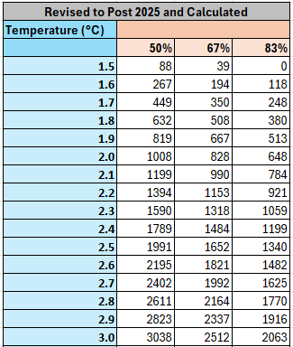
Post 2025 IPCC Carbon Budget
Based on the post-2024 carbon budget shown on the previous slide, the table at left show the post-2025 carbon budget for a range of temperature increases. The “CO2 Pathways Model” uses the values in this table to estimate the temperature increase in 2100.
Based on the post-2024 carbon budget shown on the previous slide, this table shows the post-2025 carbon budget for a range of temperature increases. The “CO2 Pathways Model” uses the values in this table to estimate the temperature increase in 2100.

Slide 7
Post 2025 IPCC Carbon Budget
Based on the post-2024 carbon budget shown on the previous slide, the table at left show the post-2025 carbon budget for a range of temperature increases. The “CO2 Pathways Model” uses the values in this table to estimate the temperature increase in 2100.
Having a revised post-2025 IPCC carbon budget means that we are no longer dependent on climate models to obtain a reasonable estimate of the expected temperature increase in 2100 as all that is needed the value for cumulative net CO2 emissions in 2100.
Having a revised post-2025 IPCC carbon budget means that we are no longer dependent on complex climate models to obtain a reasonable estimate of the expected temperature increase in 2100 as all that is needed the value for cumulative net CO2 emissions in 2100.

Slide 8
Post 2025 IPCC Carbon Budget
Based on the post-2024 carbon budget shown on the previous slide, the table at left show the post-2025 carbon budget for a range of temperature increases. The “CO2 Pathways Model” uses the values in this table to estimate the temperature increase in 2100.
Having a revised post-2025 IPCC carbon budget means that we are no longer dependent on climate models to obtain a reasonable estimate of the expected temperature increase in 2100 as all that is needed the value for cumulative net CO2 emissions in 2100.
In future years, all climate scientists need to do is to provide is chart similar to this one with the most recent best estimate of the carbon budget. A reasonable estimate of the expected temperature increase in 2100 can then easily be obtained.
In future years, all climate scientists need to do is to provide is chart similar to this one with the most recent best estimate of the carbon budget. A reasonable estimate of the expected temperature increase in 2100 can then easily be obtained.

Slide 9
CO2 Pathways Model
http://www.co2pathways.org
Two simplified ways for users to specify CO2 emission pathways:
1. By annual percent decline (2 to 8 percent) 2. By a specific year for annual CO2 emissions to reach three GTCO2 or less.
The CO2 Pathways Model includes two simplified ways for users to specify CO2 emission pathways –by an annual percent decline and by the year when annual CO2 emissions to reach three GTCO2 or less

Slide 10
CO2 Pathways Model – How it Works
The CO2 Pathways Model is very simple

Slide 11
CO2 Pathways Model – How it Works
Use the chart from a previous slide to determine the carbon budget for a percent chance and a desired temperature increase
First, use the chart from a previous slide to determine the carbon budget for a percent chance and a desired temperature increase

Slide 12
CO2 Pathways Model – How it Works
Use the chart from a previous slide to determine the carbon budget for a percent chance and a desired temperature increase
Calculate cumulative CO2 emissions from
Anthropogenic sources (using a simplified pathway)
Carbon feedbacks
CO2 captured at the source (CCS)
Next, calculate cumulative CO2 emissions from Anthropogenic sources, carbon feedbacks, and CO2 captured at the source

Slide 13
CO2 Pathways Model – How it Works
Use the chart from a previous slide to determine the carbon budget for a percent chance and a desired temperature increase
Calculate cumulative CO2 emissions from
Anthropogenic sources (using a simplified pathway)
Carbon feedbacks
CO2 captured at the source (CCS)
Calculate the amount of carbon dioxide that must be removed from the atmosphere (CDR) to meet the carbon budget
CDR = Carbon budget – (Anthropogenic + Feedbacks + CCS)
And finally, calculate the amount of carbon dioxide that must be removed from the atmosphere (CDR) to meet the carbon budget by using this simple formula

Slide 14
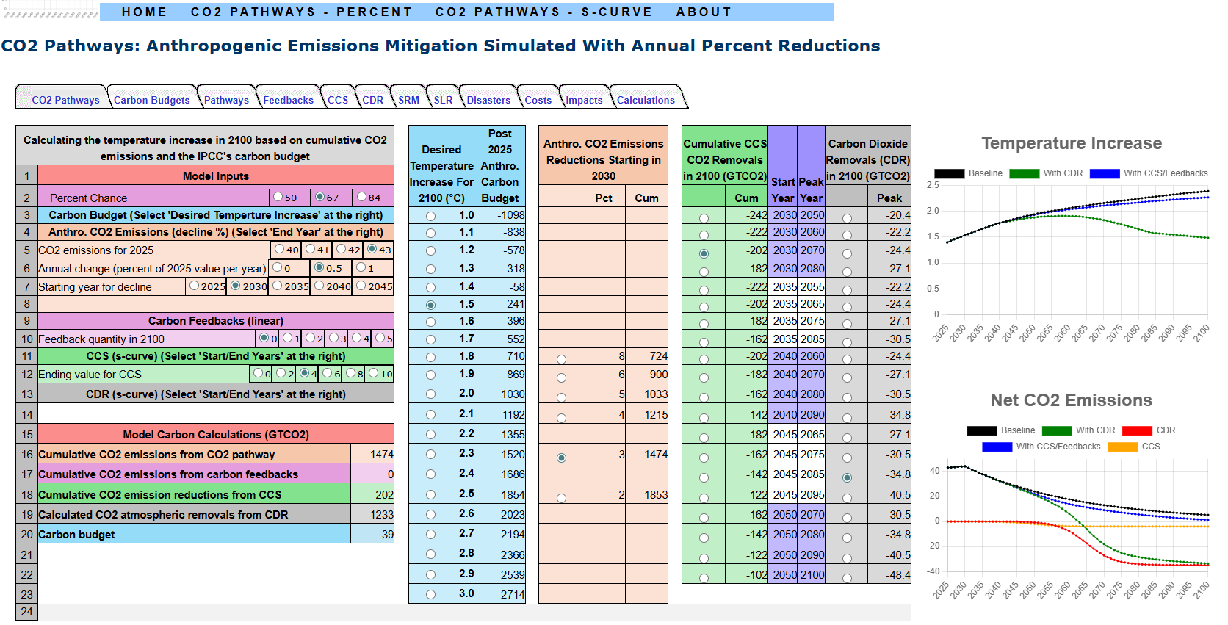
CO2 Pathways Model
This is a screen shot of the Web page where the model computes the CDR requirement when annual emissions decline at a specific percent per year. The following slides review the various sections

Slide 15
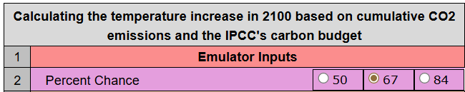
CO2 Pathways Model – Percent Chance
Three options are available
Three options are available for the Percent Chance of meeting a temperature increase

Slide 16
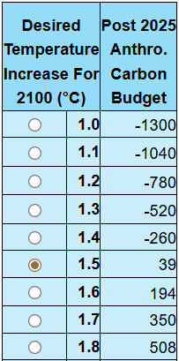
CO2 Pathways Model – Desired Temp. Incr.
A value between 1⁰C and 3⁰C can be selected.
For the desired temperature Increase, any value between 1⁰C and 3 ⁰C can be selected. Note that the corresponding carbon budget is shown to the right.

Slide 17
CO2 Pathways Model – Desired Temp. Incr.
A value between 1⁰C and 3⁰C can be selected.
In this example, a 1.5 ⁰C temperature increase has been selected and the corresponding carbon budget is 39 billion tons.

Slide 18
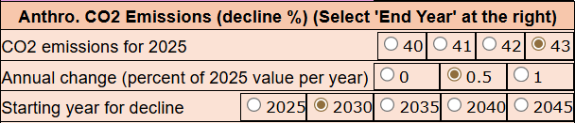
CO2 Pathways Model – Anthro. CO2 Emissions
For anthropogenic CO2 emissions, select the
CO2 emissions for 2025
Annual increase in CO2 emissions
Year when CO2 emissions start to decline
For anthropogenic CO2 emissions, select the CO2 emissions for 2025, the annual increase in CO2 emissions, and the year when CO2 emissions start to decline

Slide 19
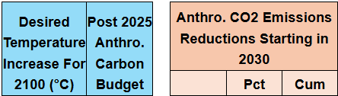
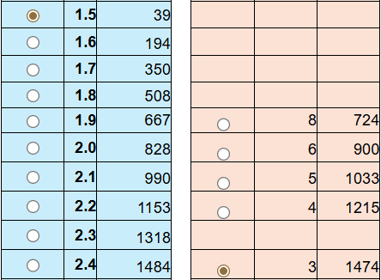
CO2 Pathways Model – Anthro. CO2 Emissions
Next, select the annual percent decline in anthropogenic emissions in the “Anthro. CO2 Emissions Reductions Starting in” section”
The cumulative CO2 emissions for various annual percent reductions are displayed in the “Anthro. CO2 Emissions Reductions Starting in” section next to the corresponding expected temperature increase.

Slide 20
CO2 Pathways Model – Anthro. CO2 Emissions
Next, select the annual percent decline in anthropogenic emissions
A three percent annual reduction results in
1474 billion tons CO2 in 2100
A temperature increase of 2.4⁰C (excluding feedbacks, CCS, and CDR)
In this example, an annual percent reduction of three percent after 2030 would result in cumulative emissions of almost 15 hundred gigatons of CO2 from 2026 through 2100, resulting in a temperature increase of about 2.4 degrees in 2100 if feedbacks, CCS, and CDR are excluded . Note that an annual 4% percent reduction is very aggressive, comparable to a WWII-level mobilization

Slide 21

CO2 Pathways Model – Carbon Feedbacks
The carbon budgets include some feedbacks. An additional quantity of emission feedbacks in 2100 can be specified here. The model assumes that the additional carbon feedback emissions start in 2025 and increase linearly to the selected value in 2100.
The carbon budgets include some feedbacks. An additional quantity of emission feedbacks in 2100 can be specified here. The model assumes that the additional carbon feedback emissions start in 2025 and increase linearly to the selected value in 2100.

Slide 22

CO2 Pathways Model – CCS
The quantity of emission feedbacks in 2100 can be specified here.
The quantity of CCS removals for 2100 can be specified in this section.

Slide 23
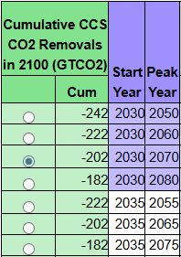
CO2 Pathways Model – CCS
The quantity of emission feedbacks in 2100 can be specified here.
The Model then calculates the cumulative CO2 removals which begin in a “Start Year” in an S-Curve and then reaches a maximum value in the “Peak Year”.
When a 2100 value is selected, the model calculates the cumulative CO2 removals. These begin in a “Start Year” in an S-Curve and then reach a maximum value in the “Peak Year”.

Slide 24
CO2 Pathways Model – CCS
The quantity of emission feedbacks in 2100 can be specified here.
The Model then calculates the cumulative CO2 removals which begin in a “Start Year” in an S-Curve and then reaches a maximum value in the “Peak Year”.
In this example, CCS begins in 2030, reaches a peak of 4 billon tons per year in 2070, and continues at 4 billon tons per year through 2100, for a cumulative total of 202 billon tons.
In this example, CCS begins in 2030, reaches a peak of 4 billon tons per year in 2070, and continues at 4 billon tons per year through 2100, for a cumulative total of 202 billon tons.

Slide 25
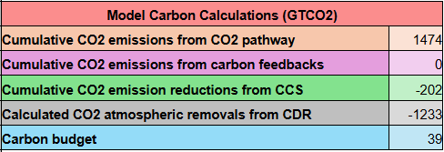
CO2 Pathways Model – CDR Calculations
The “Model Carbon Calculations” section displays values that are used to calculate the CDR requirement
The “Model Carbon Calculations” section displays values that are used to calculate the CDR requirement

Slide 26
CO2 Pathways Model – CDR Calculations
The “Model Carbon Calculations” section displays values that are used to calculate the CDR requirement
CDR = Carbon budget – (Anthropogenic + Feedbacks + CCS)
-1233 = 39 – (1472 + 0 – 202)
In this example, 1233 billion tons of CDR are required to limit the temperature increase to 1.5 ⁰C in 2100

Slide 27
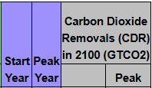
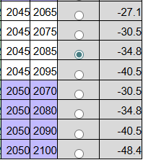
CO2 Pathways Model – CDR Calculations
The “Carbon Dioxide Removals (CDR) in 2100” section shows the quantity of CO2 removals in the peak year for a range of start and peak years
The “Carbon Dioxide Removals (CDR) in 2100” section shows the quantity of CO2 removals in the peak year for a range of start and peak years

Slide 28
CO2 Pathways Model – CDR Calculations
The “Carbon Dioxide Removals (CDR) in 2100” section shows the quantity of CO2 removals in the peak year for a range of start and peak years.
If 1233 billion tons of CDR are required, CDR starts in 2045, and CDR peaks in 2085, then the CDR requirement for the peak year is about 35 billion tons
In this example, If 1233 billion tons of CDR are required and CDR starts in 2045 and CDR peaks in 2085, then the CDR requirement for the peak year is about 35 billion tons

Slide 29
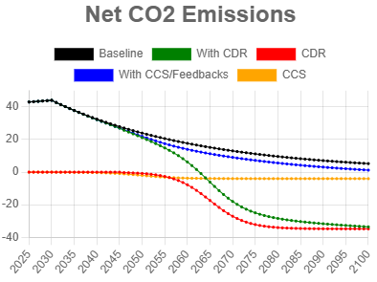
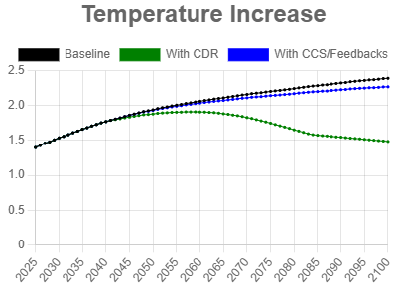
CO2 Pathways Model – Graphs
The CO2 Pathways Model provides two graphs – temperature increase and CO2 emission. The temperature increase is based on data from the EN-ROADS global climate simulator.

Slide 30
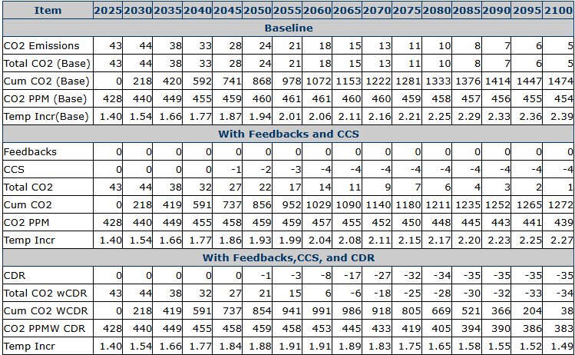
CO2 Pathways Model – Calculations Summary
A summary of the Model’s calculations can be displayed by clicking the “Calculations” tab.

Slide 31
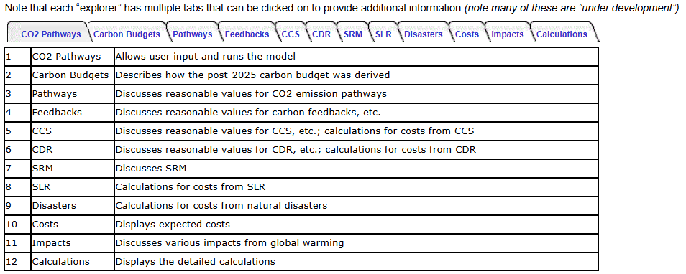
CO2 Pathways Model – Tabs
Note that each “explorer” has multiple tabs that can be clicked-on to provide additional information (note that most of these tabs are “under development”).

Slide 32
The Need for SRM
By implementing CCS and CDR at scale it should be possible to limit the temperature increase in 2100 to less that 2.0⁰C
In order to convince people that SRM might be needed (and hence the need for R&D to study the feasibility of various SRM approaches) we need to reach agreements on:
The maximum acceptable temperature increase in 2100
A carbon budget that would provide a __% chance of meeting the temperature increase goal
Realistic CO2 emission pathways
A realistic maximum that society would be willing to spend on CDR and CSS
Cost curves for CCS and CDR “at scale”
Realistic CCS and CDR “implementation pathways”
Given the above it should be possible to determine whether or not society would be willing to allocate the necessary funds to limit the temperature increase to the maximum acceptable value.
How can the CO2 Pathways Model and web site be improved to help convince people that SRM might (or might not) be necessary?
How can the CO2 Pathways Model and web site be improved to help convince people that SRM might (or might not) be necessary?

Slide 33
CO2 Pathways Model
http://www.co2pathways.org
Bruce Parker
bruce@chesdata.com
January 16, 2026
Please contact Bruce Parker if you have any questions or suggestions or would like to help him with this project.

